Slide 1
WORLD TELEVISION DAY -QUIZ-

Slide 3
1. When is World Television Day celebrated?
24th November
21st November
21st November
23rd November

Slide 4
2. When did TV become colored?
1953
1955
1953
1954

Slide 5
2. When was the broadcast of the total solar eclipse?
1962
1960
1961
1961

Slide 6
4. Who writes the lyrics for the movie?
actors
camerman
screenwriter
screenwriter

Slide 7
5. Who is in charge of the scene?
scenographer
scenographer
editor
costume designer

Slide 8
6. Who helps the actors when they forget the text?
whisperers
producer
whisperers
doubles

Slide 9
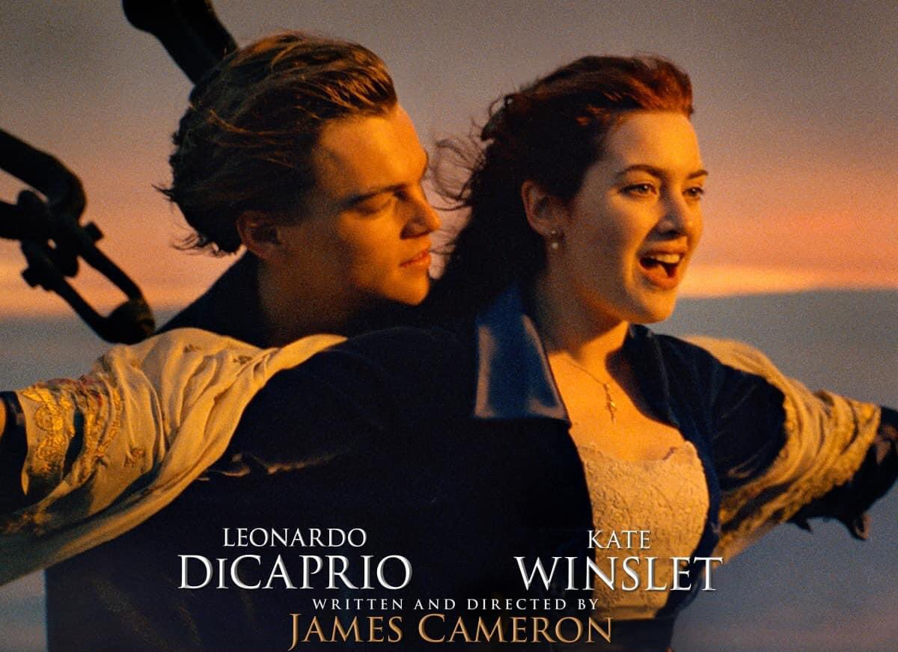
7. What movie is this?
Titanic
Titanic
Mr. and Mrs. Smith

Slide 10
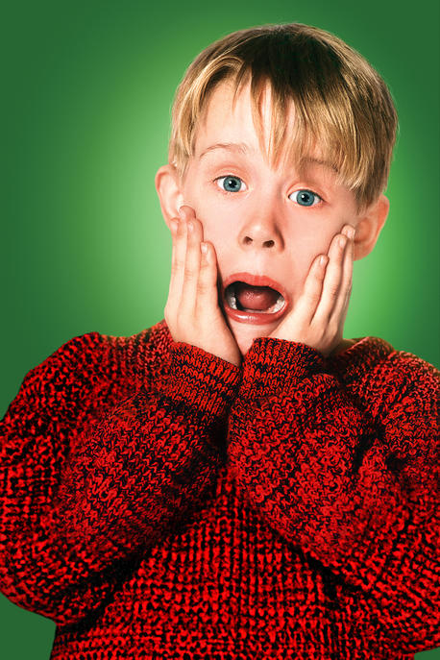
7. What movie is this?
The Grinch
Home alone
Home alone

Slide 11
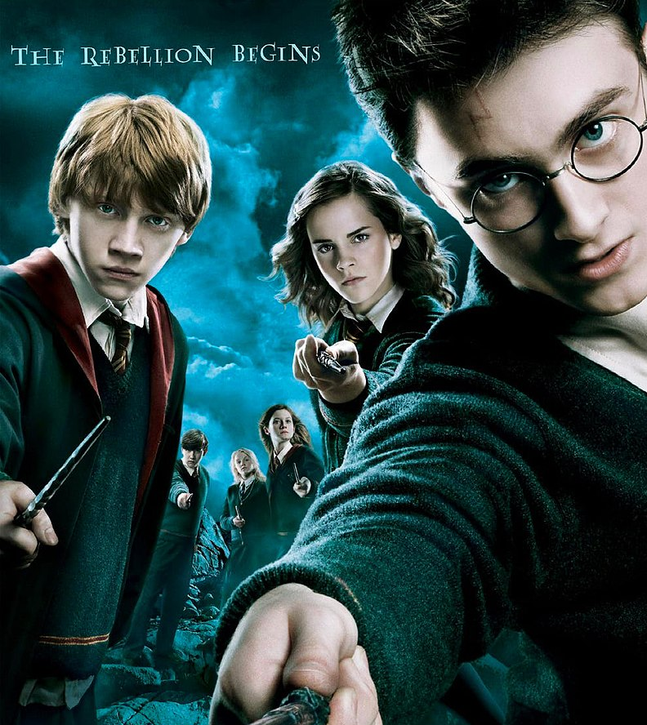
7. What movie is this?
Harry Potter
Harry Potter
Doctor Strange

Slide 12
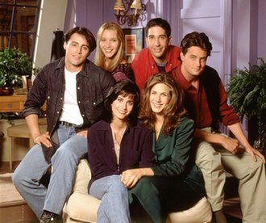
8. What series is this?
Friends
Friends
The Big Bang Theory

Slide 13
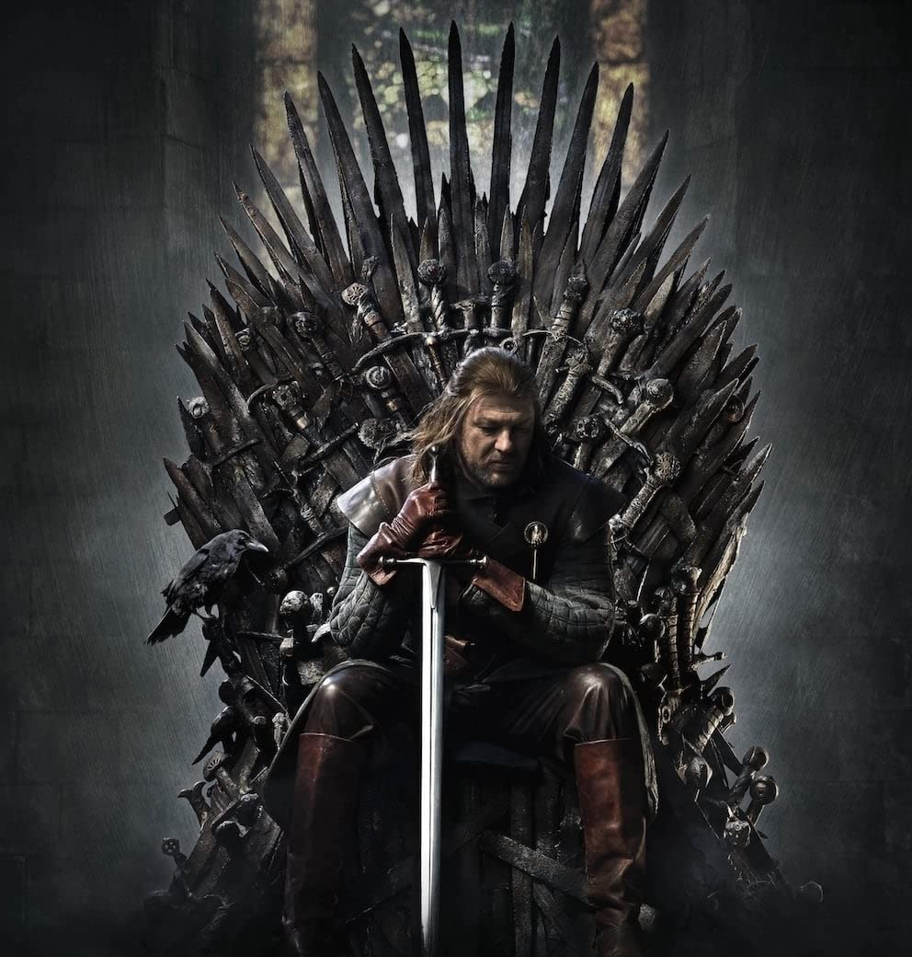
8. What series is this?
House of the Dragon
Game of Thrones
Game of Thrones

Slide 14
9. What show is this?
Skocko
Slagalica
Slagalica

Slide 15
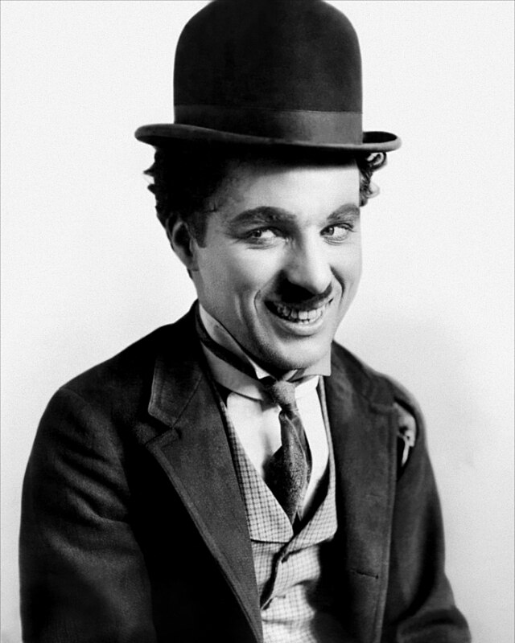
10. Which famous historical actor is this?
Buster Keaton
Charles Chaplin
Charles Chaplin

Slide 16
THE END
Аутор квиза Анђела Брдарић, ученица 8/3
ОШ „Миле Дубљевић“ Лајковац

